Slide 1
Cryptology (5)
Public Key Encryption—RSA Math
John York
Shenandoah Valley Governor’s School
yorkj@svgs.k12.va.us
Notes:
Much of the information in this course came from “Understanding Cryptography” by Christoff Parr and Jan Pelzl, Springer-Verlag 2010
Much of the classical cryptography material and most Python scripts came from “Cracking Codes with Python” by Al Sweigart, NoStarch Press 2018
Also helpful, “Cryptography Engineering” by Ferguson, Schneier, and Kohno, Wiley Publishing, 2010

Slide 2
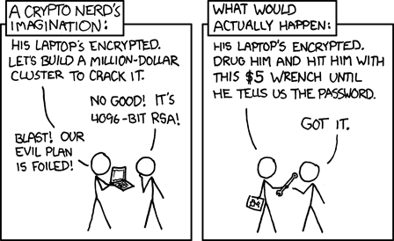
Let’s not get carried away, though…
https://imgs.xkcd.com/comics/security.png
"Actual reality: nobody cares about his secrets. (Also, I would be hard-pressed to find that wrench for $5.)"
Notes:
This is probably the key to cryptography in the real world. Developers use very secure algorithms in their software (RSA 2048, AES 256, etc.) but make some minor implementation error. The secure algorithms are still secure, but the error causes the entire system to unravel.
If you replace “hit him with this $5 wrench” with “hammer the site until we find a bug,” then you are in the real world.
Even if the bug is obscure and difficult, once it is published your security is gone.

Slide 3
Generating Large Prime Numbers
RSA key generation requires two large prime numbers, p and q
How do we get p and q? Guess!!
Pick a random number and check for primality
If not prime, pick a new random number and try again
What is the probability that a random number is prime?
For 1024-bit number, probability ≈ 1/355
For 2048-bit number, probability ≈ 1/710
On average, 355 guesses to find p, then 355 more to find q
Notes:
In selecting p and q, we have requirements:
-p and q must be prime numbers
-the product pq should have the length we need, usually 2048 bits
-p and q both be large (in the vicinity of 1024 bits for 2048 bit encryption) and close to the same size. “Cryptography Engineering”, pg 203.
Rather than use some formula to find p or q, we simply pick a random number of the proper number of bits. Then we test the number to see if it is prime. Obviously we will pick a lot of numbers that are not prime, and will have to use a lot of random numbers until we find one that is prime. This is why key generation is slow for small computers and routers.
Probabilities from “understanding Cryptography,” Parr and Pelzel, Springer 2010, page 188.

Slide 4
Primality Tests
We will have to test, on average,
355 random numbers for 1024-bit number
1024-bit p and q yields 2048-bit n
Most use Miller-Rabin Primality test
Does not tell absolutely that number is prime
Run test enough times to get probability < 2⁻⁸⁰ that number is composite
(composite means not prime)
Key generation is the most CPU intensive portion of RSA
On a small CPU (router, switch, etc.) key generation can take a minute or more
Notes:
Testing a number for primality is fairly efficient (factoring a large number is hard.) Still, your computer may have to test many random numbers to find a prime. (The average number of attempts for a 1024 number is 355, but generating a number could easily take 500. Since you need two numbers, it may take 1000 attempts in total.
The primality test does not factor our candidate number. It simply tells us if the number is *likely* to be prime, using an algorithm that includes the candidate number and a random number. It is entirely possible that in a pass through the algorithm with a single random number, the algorithm may tell us the candidate is likely prime, even when the candidate is known to be composite (not prime.) However, if we run the test enough times with enough random numbers, we can reduce the probability of making an error to 2⁻⁸⁰ or below. If our candidate number is 250 bits long, we need 11 tests. If the number is 600 bits long, we need only 3 tests. (Paar, page 191).
If Miller-Rabin says a number is composite, that is absolutely true. If it says the number is prime, there is an error probability of 2⁻⁸⁰.
A mathematical explanation of the Miller-Rabin primality test is available here. https://en.wikipedia.org/wiki/Miller%E2%80%93Rabin_primality_test or in page 190 of Paar. A Python function for the test is available in Sweigart, page 331.

Slide 5
But RSA is more complicated in practice
RSA is deterministic…same plaintext yields same ciphertext
Plaintext values x = 0, -1, and 1 have ciphertext = 0, -1, and 1
A very small message encrypted with a small public key does not exceed n, so the message can be decrypted by taking a root.
Attacker may be able to manipulate ciphertext to cause known changes on decryption--this means RSA is malleable
Same message sent to two different public keys (people) can be broken
Fix all of these with careful use of padding and hashing
Notes:
If you run RSA in the manner discussed so far, you will be vulnerable to many attacks. You can find them discussed
Understanding Cryptography, Paar, section 7.7 RSA in Practice pg 192
Cryptography Engineering, Ferguson, section 12.5 Pitfalls Using RSA pg 205
https://en.wikipedia.org/wiki/RSA_(cryptosystem), Attacks against Plain RSA section
If you encrypt the same plaintext, the ciphertext will also be the same. We’ve already talked about this one.
For the small message and key problem, assume the public key e = 7, message m = 8. The encryption will perform m^{e} = 8⁷ = 2,097,152. If n is larger than this, say 10,000,000, modular arithmetic will not come into play since
2,097,152 mod 10,000,000 = 2,097,152. (The number does not “wrap.”) Then the attacker can recover m by taking the 7th root of 2,097,152.
Malleable (from Paar, pg 192). If an attacker doesn’t know what’s been encrypted, but just wants to double it, (2e*y)^{d} = 2^{ed}*y^{ed} = 2*x mod n. The plaintext has been doubled and the receiver may not realize it.
To use RSA in practice you have to use carefully chosen padding and hashing.

Slide 6
RSA in Practice
Public Key Cryptography Standards (PKCS)
Generally accepted standards in public key cryptography
Started by RSA Corporation in early 1990’s
PKCS#1 is the standard for RSA encryption
PKCS#1 specifies complicated padding, hashing, and XOR for plaintext before it is encrypted
PKCS#1 OAEP (Optimal asymmetric encryption padding) version is currently approved
Real-world RSA implementations are more complicated than our demo in the last lesson. Proper RSA encryption algorithms will support PKCS#1 and OAEP and do this for you.
Notes:
PKCS1 is specified in RFC 2013, 3447, and 8017. https://tools.ietf.org/html/rfc8017
This link is a copy of PKCS1, but with better drawings. https://www.emc.com/collateral/white-papers/h11300-pkcs-1v2-2-rsa-cryptography-standard-wp.pdf
See Figure 1: EME-OAEP Encoding Operation on page 20. This is shown in the next slide.
PKCS#1 and OAEP are fancy names for a padding and hashing scheme that has been proven to fix the problems with schoolbook RSA.

Slide 7
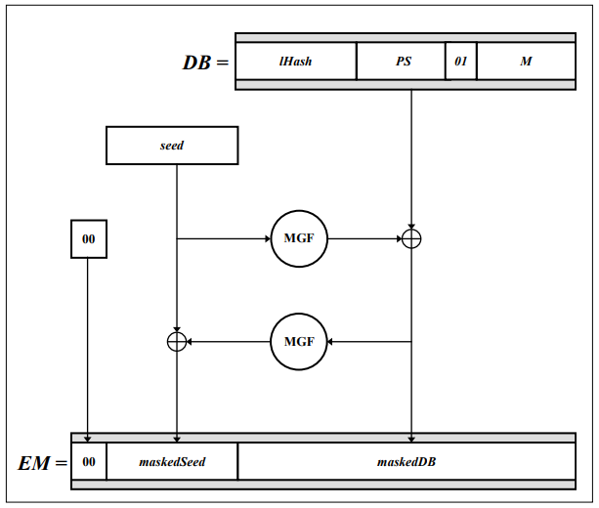
PKCS#1 Hash/Padding Scheme
M is the message
lHash—usually SHA hash of an empty string
PS—padding, 0’s as needed for size
MGF—Mask Generation Function, usually SHA-1 or SHA-256
Seed--random
https://www.emc.com/collateral/white-papers/h11300-pkcs-1v2-2-rsa-cryptography-standard-wp.pdf
Notes:
Students do not have to understand this figure, other than to know:
Because OAEP uses a seed, encrypting the same plaintext will result in a different ciphertext every time.
Even if the message is short, it expands it so that the Encoded Message EM fills the message block
Attacks against short or repeated messages won’t work
It uses up some of your precious bits--if lHash, and seed are each 256 bits, you’ve lost 512 bits.
However, if you like puzzles and really want to decode EM in the message above and recover the message M:
XOR is its own inverse. If A xor B = C, then B xor C = A, or A xor C = B
Consider the fields lHash and PS to be known to everyone, since they are part of the implementation. You can consider MGF to be a SHA hash, again known.
You can recover the seed, and then the message M in this manner
Hash the maskedDB with the MGF (known), then XOR the result with the maskedSeed. This gives you the seed.
Hash the seed with the MGF, then XOR the result with the maskedDB. This gives you the DB
Since lHash, PS, and 01 are known, you can extract the message

Slide 8
RSA Math
Basis of RSA is that the modulus (n) is the product of two primes
n = p * q where p and q are prime
Public key, e, and Private key, d, are inverses mod Φ
Ciphertext = Plaintext^{e} mod n
Decrypt, Ciphertext^{d} mod n = Plaintext^{ed} mod n = Plaintext
Computing d as inverse of e mod n does not work
n is not prime, so d ≠ e⁻¹ mod n
Must use Φ = (p - 1) * (q – 1) as modulus
d = e⁻¹ mod Φ
Notes:
Everyone knows n, but only we know p and q because we chose them
We pick the public key and compute the private key. Only we can compute the private key, because the computation requires that p and q are known. The private key is computed modulo Λ(n) or Φ(n), which depend on p and q.
Note that if you try to compute the private key as the inverse of the private key modulo n, it won’t work. You can test this yourself.
In theory, the public and private keys are interchangeable until you give your public key to the world. In practice, there is good reason to pick your public key first and make it a small number. Most keys are used much more often for verifying signatures (use public key) than in generating signatures (private key.) Having a small public key saves time.
Small public keys have been shown to be secure, as small as 3, but NIST requires public keys to be 65537 or larger.
Small private keys are insecure, and should never be used. The key, d, should be as many bits long as n (the modulus.)

Slide 9
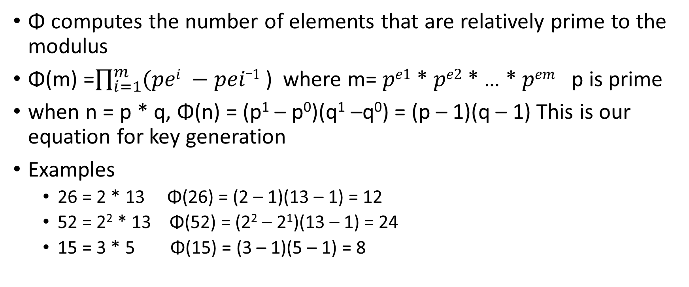
Euler’s Totient Function Φ
Φ computes the number of elements that are relatively prime to the modulus
Φ(m) =$\prod_{i=1}^{m}{(pei −pei_1}$ ) where m= $pe1$* $pe2$* … * $pem$ p is prime
when n = p * q, Φ(n) = (p¹ – p⁰)(q¹ –q⁰) = (p – 1)(q – 1) This is our equation for key generation
Examples
26 = 2 * 13 Φ(26) = (2 – 1)(13 – 1) = 12
52 = 2² * 13 Φ(52) = (2² – 2¹)(13 – 1) = 24
15 = 3 * 5 Φ(15) = (3 – 1)(5 – 1) = 8

Slide 10
ℤ* Only include numbers with multiplicative inverse
Fulfills identity, closure, commutative, inverse laws
Addition is broken, so it is a group (only one operation, fields have addition and multiplication)
ℤ₁₅* Multiply | 1 | 2 | 4 | 7 | 8 | 11 | 13 | 14
1 | 1 | 2 | 4 | 7 | 8 | 11 | 13 | 14
2 | 2 | 4 | 8 | 14 | 1 | 7 | 11 | 13
4 | 4 | 8 | 1 | 13 | 2 | 14 | 7 | 11
7 | 7 | 14 | 13 | 4 | 11 | 2 | 1 | 8
8 | 8 | 1 | 2 | 11 | 4 | 13 | 14 | 7
11 | 11 | 7 | 14 | 13 | 13 | 1 | 8 | 4
13 | 13 | 11 | 7 | 1 | 14 | 8 | 4 | 2
14 | 14 | 13 | 11 | 8 | 7 | 4 | 2 | 1
Example ℤ₁₅*

Slide 11
Λ and Φ
Original RSA paper used Euler’s Φ(n) function to compute keys d, e
Current RSA algorithms use Λ(n) = LCM(p - 1, q - 1), where LCM is Least Common Multiple
LCM(p - 1, q - 1) = (p - 1)(q - 1) / GCD((p - 1)(q - 1))
= Φ(n) / GCD((p - 1)(q - 1))
Usually, GCD((p - 1)(q - 1)) is small, very often 2
Either Λ or Φ will work for computing d and e, but Λ is smaller
Less computation when using Λ
Notes:
Many textbooks explain RSA encryption using Φ(n) to compute the private key as the inverse of the public key, modulo Φ(n), because that’s the what the original paper used. There are several proofs that the system works when the inverse of the public key is computed in modulo Φ(n). The key point is that Φ(n) gives you the number of elements in a set where multiplicative inverse works. Multiplicative inverse mod n does not work, because n is not a prime number.
Modern implementations use the Least Common Multiple of p-1 and q-1 instead of just the product. The lcm is usually smaller than Φ(n), so the private key is smaller as well. Smaller keys mean less computation.
Euler’s Φ(n) function
n factors into p₁^{e1} * p₂^{e2} * …
Φ(n) = (p₁^{e1} - p₁^{e1-1} )(p₂^{e2} - p₂^{e2-1} )…
If n = 84, n = 2² * 3¹ * 7¹
Φ(n) = (2² - 2¹)(3¹ - 3⁰)(7¹ - 7⁰) = (4 -2)(3 - 1)(7 - 1)
= 2*2*6 = 24
There are 24 numbers between 1 and 83 that are relatively prime to 84

Slide 12
Pseudo Random Number Generator (PRNG)
The PRNG that selects p and q must be as close to random as possible
If p and q are chosen from a substantially smaller space than the keyspace (2²⁰⁴⁸ currently) then an attacker may be able to factor n into p * q
At that point, your implementation of RSA is broken
Your public key [n, e] must be different from everyone else’s
Otherwise, their private key is the same as yours
Your n must be different from everyone else’s
Otherwise, people with the same n already know p and q and can compute your private key
Multiple keys that share p or q can be quickly factored
PRNG is important
Notes:
If p and q are not truly random, and not chosen properly, security using those keys is weak. These two papers describe problems with insecure RSA keys that are presently in use.
https://eprint.iacr.org/2012/064.pdf “Ron was wrong, Whit is right”
https://factorable.net/weakkeys12.extended.pdf “Mining Your Ps and Qs: Detection of Widespread Weak Keys in Network Devices”

Slide 13
Math—Bottom Line
[n, e] is public key
Since n is product of two large primes p and q
Cannot calculate d directly—attacker cannot compute d
We can calculate d = e⁻¹ mod Λ(n) since we know p and q
[n, d] is private key
We are only ones with private key
Encrypt, y = message^{e} message is integer [2..n-1]
Decrypt, message = y^{d}
Quality of PRNG is important when selecting p and q
Notes:
So, to recap…
The numbers p, q, and e are chosen. The modulus n is just p*q. The private key d is the inverse of e, and can only be computed if you know p or q.
If we choose p, q, and e wisely, and keep p and q secret, attackers cannot compute d and cannot decrypt our messages.
The encryption/decryption works because d and e are multiplicative inverses.
y^{d} = x^{de} = x¹ = x (x is the message)
If we don’t choose p, q, and e well, or don’t use padding that includes a random seed, our encryption can easily be broken.

